Slide 1
Bankruptcy prediction
machine learning approach using financial drivers

Slide 2
Business problem
Calculate the likelihood of bankruptcy using financial characteristics
Analytical problem: Developing a machine learning model which takes key financial drivers as input and gives out the probability of bankruptcy.

Slide 3
Dataset description
The historical dataset available for solutioning spans across 5years with 64 finance variables and a target class with a total row count of 43405
All the variables in the dataset are continuous variables except the target variable
As expected, the dataset is highly imbalanced with class=1(bankrupt) being the minority class.

Slide 4
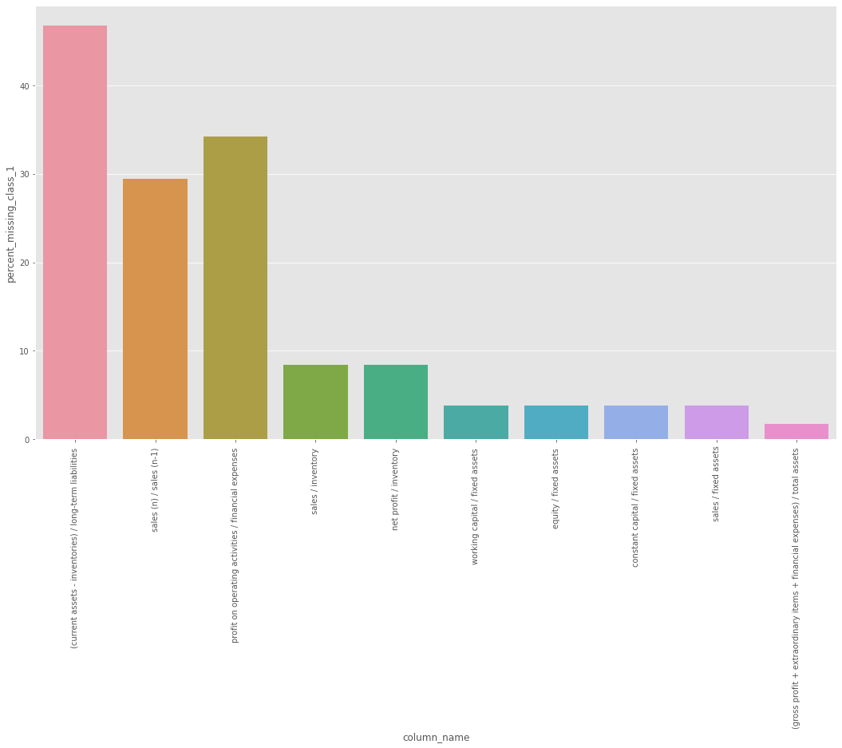
Exploratory data analysis
Most of the financial fields in the dataset have missing values.
(current assets - inventories) / long-term liabilities has the highest number of missing values and 45.5% of the missing values belong to the bankrupt class
Conclusion- Missing value in certain fields are a important driver for bankruptcy

Slide 5
Outlier Detection/Treatment
Isolation forest which is a unsupervised cluster analysis was used to identify outliers
A total of 591 outliers were identified over the 5year data points.
What more could have been done? - Could have tried generating features which indicate outliers for each column in the dataset. This would give the contribution of outliers to bankruptcy.

Slide 6
Data cleaning and feature engineering
Generated features for each column in the dataset(except the class and year) which indicate if the value was missing for a particular row.
The only quality issue with the dataset was missing values. As there was a lot of variation in the columns so used median to impute the missing values.
Created a feature for the overall dataset called Outlier_Ind which flags anomalous rows in the dataset.
The splitting of data into train and test. This could have been tested better with the test size varying slightly.
Stratified sampling could have been tried after a little more exploration of the strata’s.

Slide 7
Model selection: Initial Intuition
The dataset was highly imbalanced so going for simpler algorithms like Logistic Regression or SVM was the choice in the beginning.
The initial thought was to use simpler algorithms and avoid complexities in tuning them over the long run.
All the variables in the dataset except the class and generated features were continuous variables. So boosting was another choice. I have used on bagging classifier(Random Forest) but it was just to prove a point that bagging shouldn’t be used in this scenario. Reason- Bagging needs the 1st split to be the best split whereas boosting creates weak learners and keeps on improving over incorrect splits.
What more could have been done? – I had plans to experiment with XGBOOST and Neural Networks to test for the performance.

Slide 8
Model evaluation
The problem highly relies on predicting the companies that are more likely to get bankrupt along with their likelihood, so Recall is the metric used to evaluate the performance of the solution.
Logistic Regression and Gradient Boosted Machines had decent enough recall values even after cross validation.
Logistic Regression recall score: 50.12%
Gradient Boosted Machine recall score: 36.06%
AdaBoost and Random Forest had similar recall scores of 14.16% and 14.01% respectively.
Note: All these models are base models with a lot of scope for improvement.

Slide 9
Next actions
Using f_classif or SelectFromModel for feature selection
Developing a ML pipeline to execute different stages of the ML workflow
Model performance tuning using Grid Search CV or Randomized Search CV
LIME and SHAP to improve the interpretability of the ML models for non-technical users
Tableau dashboard to track ML performance over time. Mine the datapoints which are frequently misclassified. Track data quality over time, etc.
Creating a streamlit app to host the codebase as an app where the user can drop the financial data and get the likelihood of bankruptcy. (note: The user has to provide the #year to get the likelihood for that #year

Slide 10
Feedback
Questions?
Thank You
Github: https://github.com/BiswajeetNayak/BankruptcyPrediction
Https Clone Repo: https://github.com/BiswajeetNayak/BankruptcyPrediction.git
SSH Clone Repo: git@github.com:BiswajeetNayak/BankruptcyPrediction.git

